Slide 1
MGT 388: Finance and Law for Engineers
Pricing Decisions

Slide 2
Lecture Outline
Economic Theory
Cost plus pricing – Absorption costing
- Variable costing
Target pricing
Life Cycle Analysis
Discounting

Slide 3

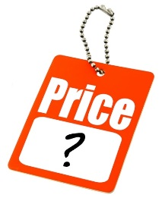

Economic Theory
The price of a good or service is determined in the market.
Demand is dependant on price.
For most goods and services if price goes down demand will increase.

Slide 4
Demand Curve
Price
P1
P2
Demand curve
Q1 Q2 Quantity

Slide 5

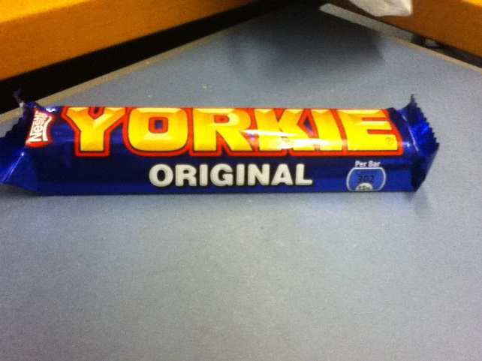
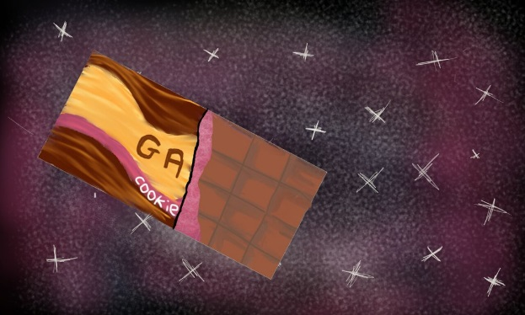
Elasticity of demand
The shape of the demand curve depends on elasticity.
If a change in price leads to a more than proportionate change in quantity demanded then demand is said to be elastic.
Products which can swapped/substituted for a similar product have elastic demand.

Slide 6
Elastic demand curve
Increase in revenue
Price
Decrease in revenue
P1
P Demand
Q1 Q

Slide 7
Elasticity of Demand
If a change in price leads to a less than proportionate change in quantity demanded then demand is said to be inelastic.
Product that have inelastic demand are often premium or luxury products.
Aston Martin

Slide 8
Inelastic Demand Curve
Increase in revenue Price
Decrease in revenue
P1
P
Demand
Q1Q

Slide 9
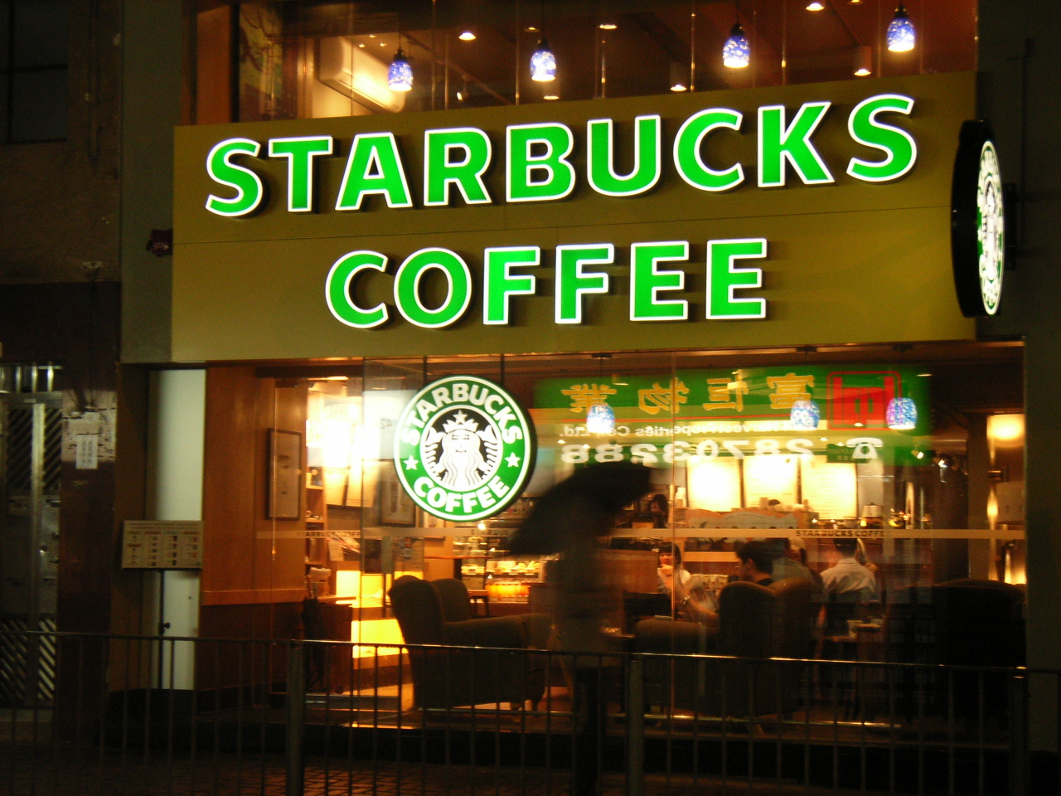
Case Study- Starbucks

Slide 10


Elasticity of demand and Starbucks
Coffee elastic demand??
2009 US economy was in recession and consumers were cutting back or switching to cheaper outlets
8%

Slide 11

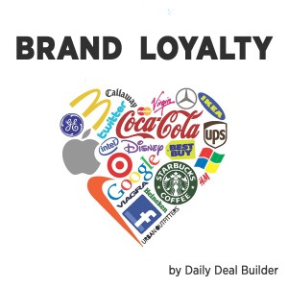
Elasticity of demand and Starbucks
Some customers were price sensitive.
A reduction in price would not be
enough to attract back these customers, they They had changed their consumption habits.
The customers who remained were not price sensitive (inelastic demand).
When the price increased
these customers stayed loyal
and total profits were maintained
despite the recession.

Slide 12
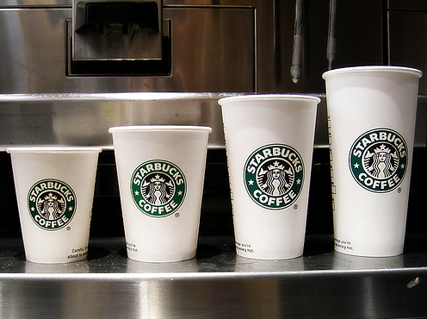
Elasticity of demand and Starbucks
Starbucks continues with value based pricing
Increase profits by increasing prices on selected products – small coffees
Inform customers of limited price increase -due to labour and commodity costs.
Inelastic demand curve few customers went elsewhere, some switched product to large which had better margins.
So profitability improved.

Slide 13
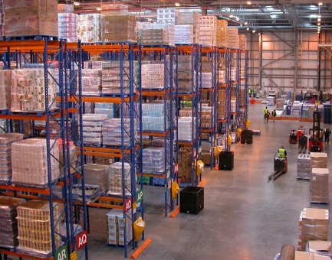
Economic Theory
Supply of a good or service is dependant on price.
For most goods and services the higher the price the greater the supply.
Current suppliers seek to produce more and new suppliers enter the market.

Slide 14
Supply Curve
Price Supply curve
P1
P2
Q2 Q1

Slide 15
Market Price – Equilibrium Price
Price
Supply
MP
Demand
QD MQ QS Quantity

Slide 16
Market Price – Equilibrium Price
Price Supply
MP
Demand
QS MQ QD

Slide 17
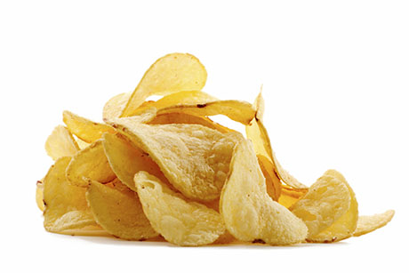


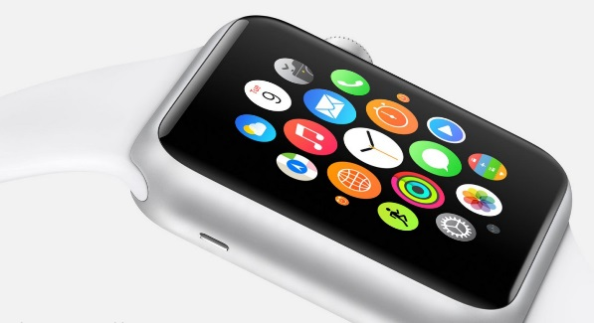
Do You Have To Accept Market Price
Competitive market with
a large number of buyers and seller
with similar products – Yes
Luxury item/premium product No
Few competitors or monopoly
No
Brand –reputation
No

Slide 18

Cost Based Pricing- Absorption Costing
Absorption costing is used to calculate a product cost.
A method of pricing would be to add a mark-up to the product cost to account for non-manufacturing overheads and the return that the business wants.

Slide 19
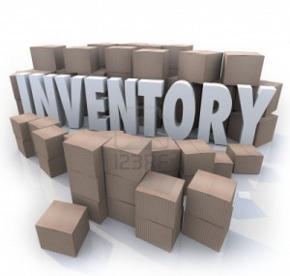
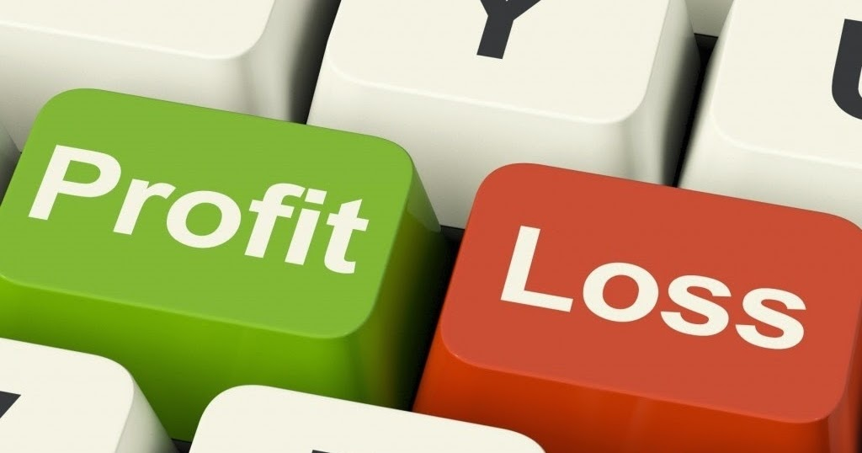
Cost Based Pricing- Absorption Costing
Production overheads have been allocated to products via an arbitrary process.
If the allocation of overheads has led to some products being over costed and others under costed the price may be out of line with the market.
Incorrect pricing may lead to surplus inventory or the business achieving a lower return than required.

Slide 20
Cost Based Pricing- Marginal costing
Marginal costing - calculate the direct cost of a product and apply a suitable mark.
The mark-up should cover all overheads and allow for a profit.
Beware the mark-up needs to be realistic if the price is to be competitive.
In the short term it is financially viable to price a product just to cover direct costs.

Slide 21
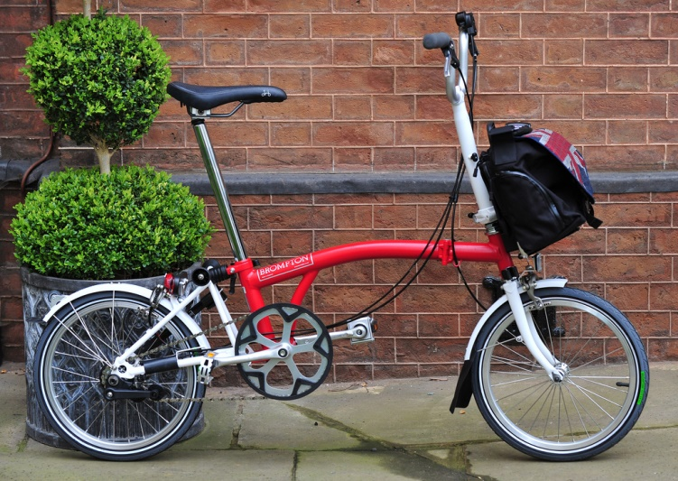
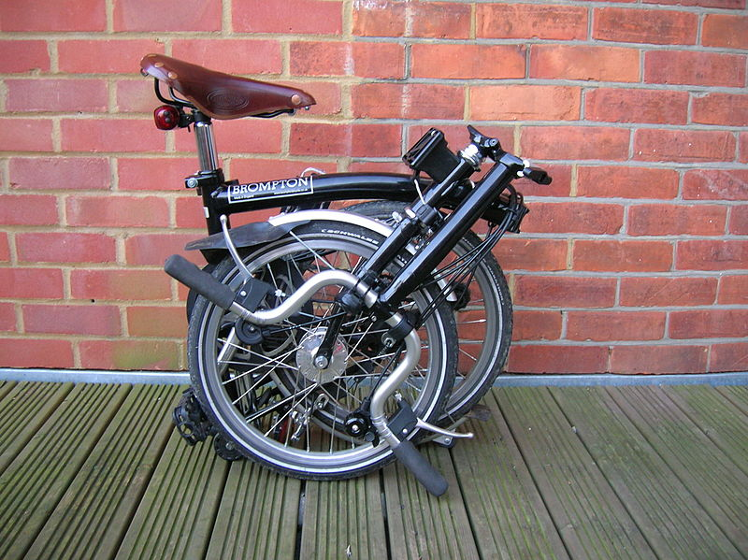
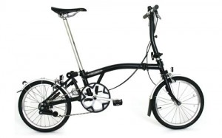
Case Study Brompton Bikes

Slide 22

Brompton Bikes
Brompton Bikes operates a cost plus approach to pricing
Between 2005-10 costs had increased and margins fallen
Between 2010-13 significant price rises to recover margins
Since 2013 prices increased but not as sharply

Slide 23
Brompton Bikes
The company does not expect brand loyalty or operate premium pricing
Price rises are due to new features and technical improvements, which have led to increased costs.
(Hard to operate consistently at less than 40% gross profit margin)

Slide 24

Target Pricing
The market for a product is analysed and a price is established.
An acceptable profit margin is determined and then the cost for which the product must be produced calculated.

Slide 25
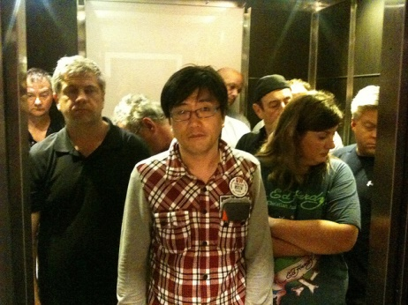
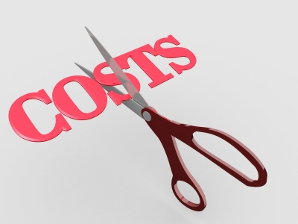

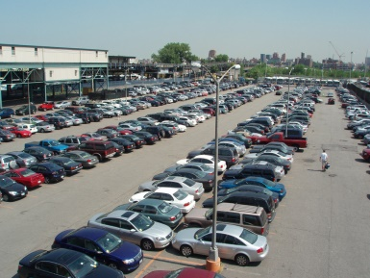
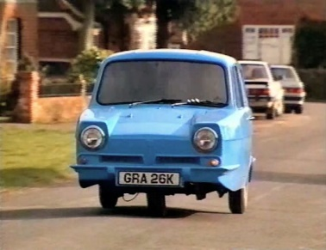
Target Pricing
BUT what if the price established is lower than the current cost to produce/supply
Cost reduction programmes
Re-engineering a product
Increasing volume (reduce unit cost)
Lower quality or reduced specification

Slide 26
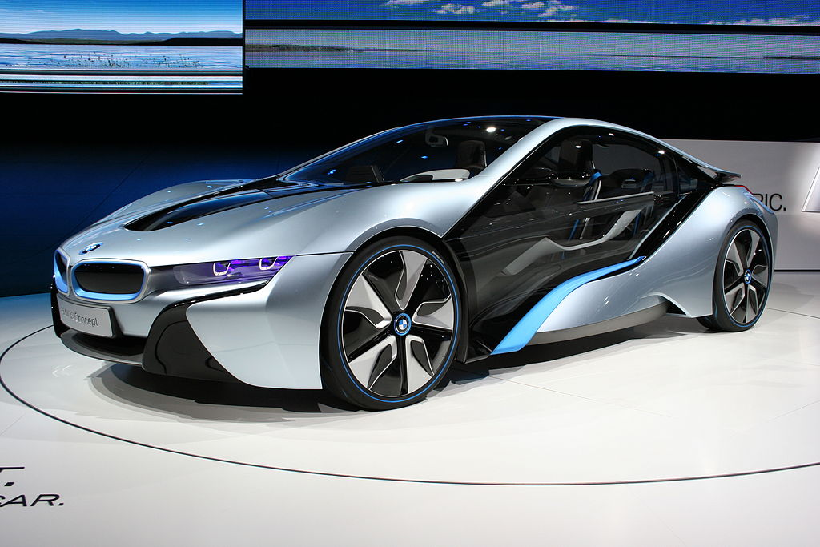
Target pricing: Car Industry
References:
Target Pricing a marketing tool for pricing new cars. Omar 1997
Brand name effects, segment differences and product characteristics. Baltas et al 2009

Slide 27
Target Pricing Car Industry
In 70’s full costing techniques led to unrealistic overhead allocation.
Increased competition came from regions with a lower cost base as technical differentiation became more difficult.
Price reduction led to lower margins with insufficient returns for investors.

Slide 28
Target pricing – Car Industry
The answer set price first work back to cost:
To arrive at price use segmental analysis and branding.
Market mapping – look at the future dimension of market place, look at customer segments and target most attractive.
Look at quality and functionality/specification, volumes, design and position of brand in market

Slide 29
Target Pricing- Car Industry
Mainstream segments
The price will determine the specification, horsepower, engine capacity, speed and safety features
High end segments premium pricing.
A premium price for a brand can be obtained if:
Awareness of brand both for the make such as BMW but also model mini
Perceived quality of product
Uniqueness of product the launch of BMW Z8 came after release of James Bond World is not enough
Social Image - Volkswagen
Corporate social responsibility

Slide 30
Nissan & Renault
Connected cars
Smart cars with the ability to learn and predict driving habits.
Need to find the right balance between providing enough benefit to the consumer and justifying investment
Consultancy firm PWC looking at how much consumers will pay. ($10,000 up front rather than subscription)

Slide 31
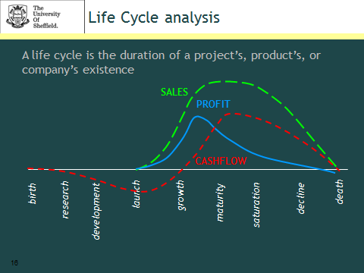

Slide 32
Life cycle analysis
For products with a dynamic environment cost plus pricing is not relevant.
Money will have been invested in research and development before a product is launched and these costs as well as costs of production need to be recouped.
Initial production costs per unit will be high, staff training, new methods of manufacture, new processes.
Advertising and marketing costs will also be high.
These unit costs should fall further into life cycle of product.

Slide 33
Life cycle analysis
The sales price will initially be high. New product to market, no competition.
If market price is high competitors will enter the market unless the process or product can be protected.
As more of the product is supplied or similar products are supplied the price will fall.
Eventually the innovation will be overtaken.
Pricing in this type of environment need careful consideration will accurate forecasts of sales and cost over the life of the product.

Slide 34
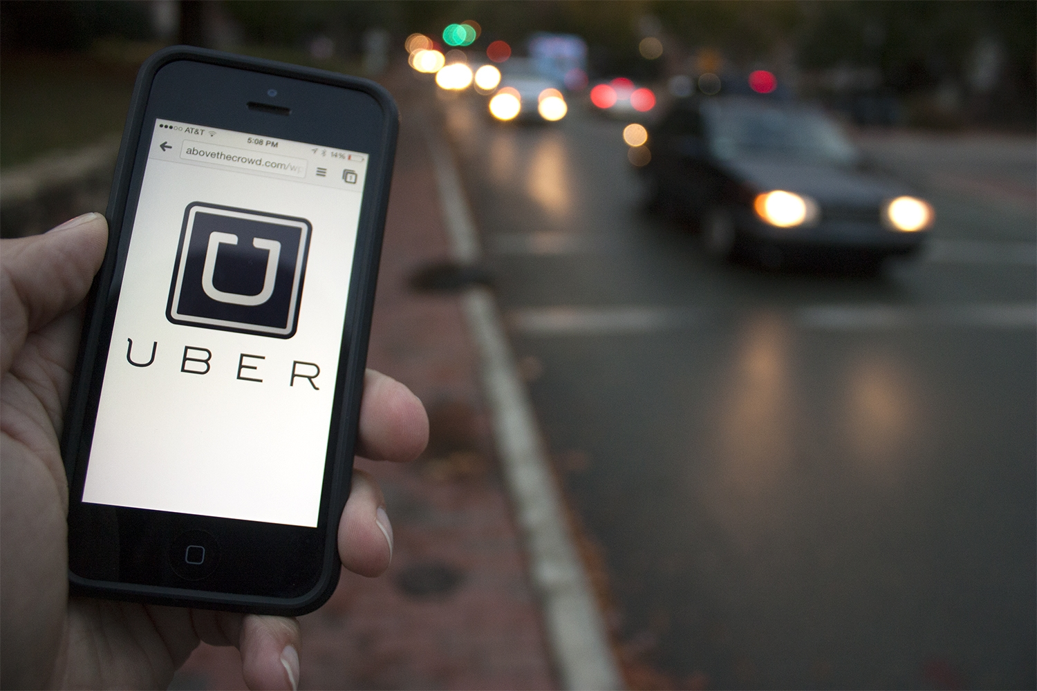
Personalised Pricing

Slide 35
Uber Personalised Pricing
Uber operates via a smart phone app.
The business has developed a surge pricing algorithm so that the fare a customer pays depends on demand and supply at that point.
When demand is high and inelastic a higher fare is charged which should encourage more drivers to operate.

Slide 36
Uber Personalised Pricing
Pricing algorithm can be used for more than surge pricing.
Higher prices can be charged from taking someone to expensive areas or to expensive destinations.

Slide 37
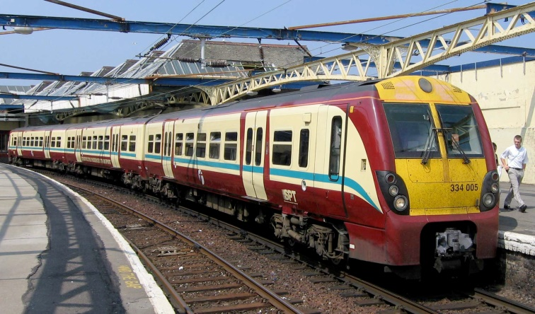

Discounting & Introductory Offers
A business may discount prices either at the beginning of a sales period to attract initial custom or at the end to ensure all products sold.
Rail fares (Earlier booking
cheaper tickets)
Introductory offers –banks, energy companies

